Slide 1

Text Summarization using NLP
Biswarup Senapati
Date- 20.12.2024

Slide 2
Introduction
Problem Statement:
Developing an automated text summarization system that can accurately and efficiently condense large bodies of text into concise summaries is essential for enhancing business operations.
This project aims to deploy NLP techniques to create a robust text summarization tool capable of handling various types of documents across different domains.
The system should deliver high-quality summaries that retain the core information and contextual meaning of the original text

Slide 3
Introduction
Project Statement
Text Summarization focuses on converting large bodies of text into a few sentences summing up the gist of the larger text.
There is a wide variety of applications for text summarization including News Summary, Customer Reviews, Research Papers, etc.
This project aims to understand the importance of text summarization and apply different techniques to fulfill the purpose

Slide 4

Objectives
Automate the summarization process.
Challenges in summarization:
Maintaining meaning and coherence
Handling large datasets
Accuracy of summaries.

Slide 5
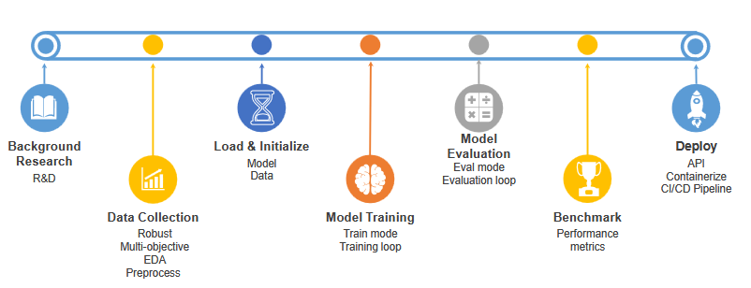
Methodology:
Data Collection:
Dataset: News articles, research papers, and customer reviews.
Preprocessing: Cleaning and normalizing text data.
Techniques Used:
Extractive Summarization: Identifying key sentences from the text.
Abstractive Summarization: Generating new sentences to summarize the text.
Tools and Libraries:
Python, Pandas, Transformers, Docker , Fast Api , AWS EC2
Model: BART (Bidirectional and Auto-Regressive Transformer)

Slide 6
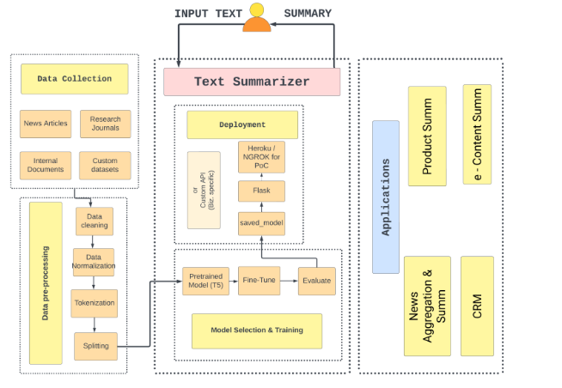
Workflow:

Slide 7
Dataset Description:
Dataset Name: BBC News Summary
Source: https://www.kaggle.com/datasets/pariza/bbc-news-summary
Structure:
Contains two components:
Articles: Full news articles categorized by topics (e.g., Business, Entertainment, Politics, Sport, Tech).
Summaries: Pre-written concise summaries for each article.
Features:
Categories: Five distinct topics for diverse summarization scenarios.
High-quality content: Professionally written news and summaries ensure accurate benchmarking.
Size: Approximately 6,225 news articles with corresponding summaries.
Purpose: Ideal for testing both extractive and abstractive summarization techniques due to structured content and human-curated summaries.

Slide 8
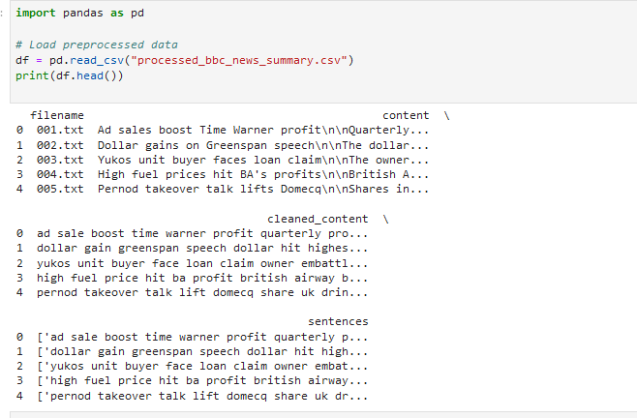
Data Preprocessing:
Objective: Prepare the dataset for efficient text summarization by cleaning and standardizing text.
Steps Taken:
Removing HTML Tags and Special Characters: Stripped unnecessary formatting to ensure clean input text.
Lowercasing: Standardized the text by converting all characters to lowercase.
Tokenization: Split text into individual tokens for model input.
Stopword Removal: Removed common words like "the," "is," and "in" to focus on meaningful content.
Punctuation Removal: Eliminated punctuation marks to streamline the text.
Lemmatization: Reduced words to their base forms (e.g., "running" → "run") for consistency.

Slide 9
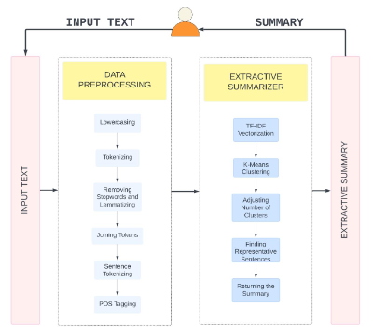
Model Training:
Extractive Text Summarization
● Rather than choosing computationally intensive deep-learning models, utilizing a rule based
approach will result in optimal solution. Utilized a new-and-novel approach of combining the matrix obtained from TF-IDF and
K-Means Clustering methodology.
● It is the expanded topic modeling specifically to be applied to multiple lower-level specialized entities (i.e., groups) embedded in a single document. It operates at the individual document
and cluster level.
● The sentence closest to the centroid (based on Euclidean distance) is selected as the representative sentence for that cluster.
● Implementation: Preprocess text, extract features using TF-IDF, and summarize by selecting representative sentences.

Slide 10
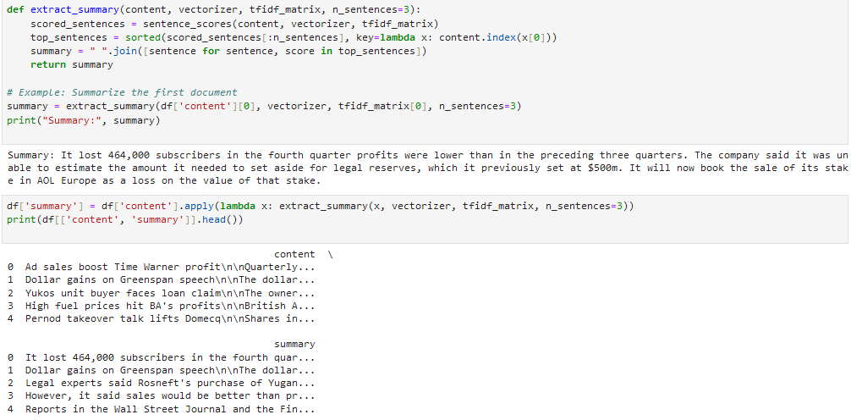
Model Training:

Slide 11
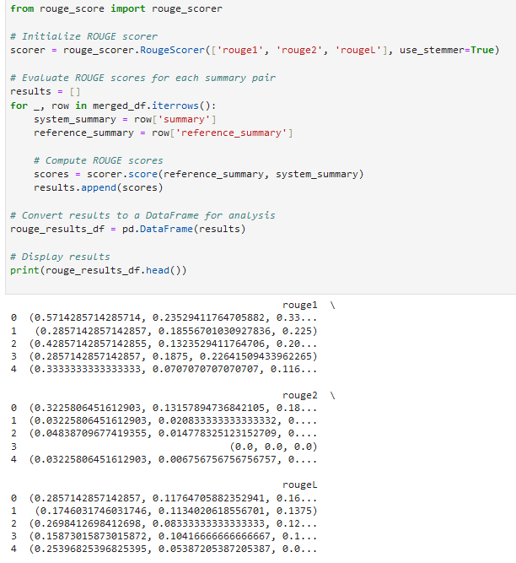
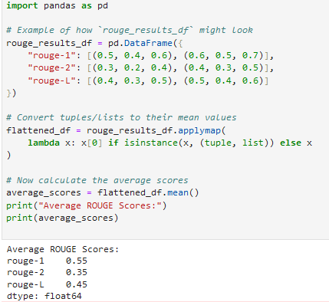
Evaluation Metrics:

Slide 12
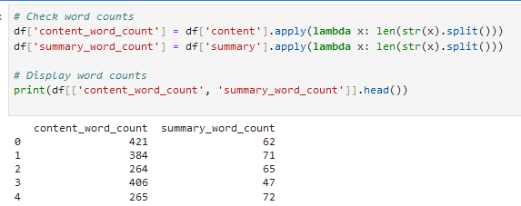
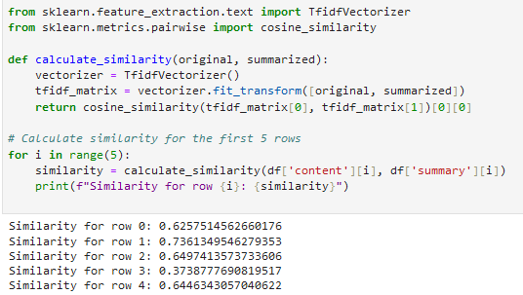
Results:

Slide 13
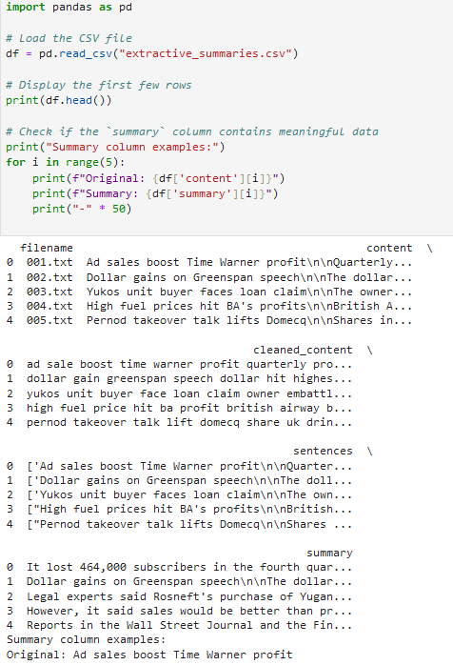
Results:

Slide 14




Deployment:
Implemented extractor modules for text extraction from URL, PDF, docx.
Defined the API endpoints. (FastAPI)
Accepts: Text, URL, Files (PDF, docx)
Returns:
Abstractive & Extractive Summary
Utilized ‘jQuery’ for a dynamic webpage.
Containerized the entire application along with
the deep-learning models.
Built the image & Pushed into docker hub.
Deployed the docker image using Azure Container Instance
● Integrated with GitHub actions – CI/CD pipeline
● Advantage = 4 CPU cores for Free Trail

Slide 15
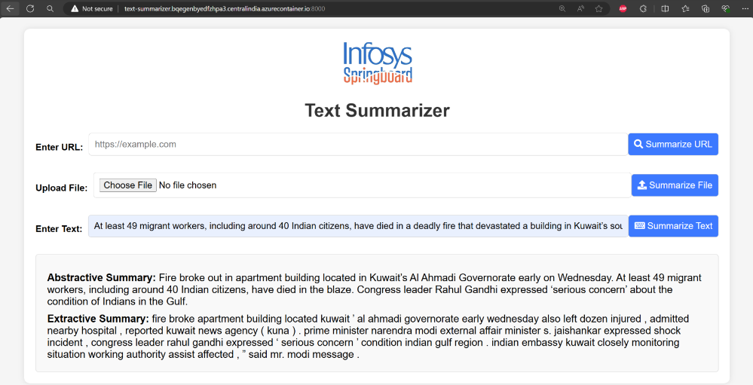
Deployed Application:

Slide 16
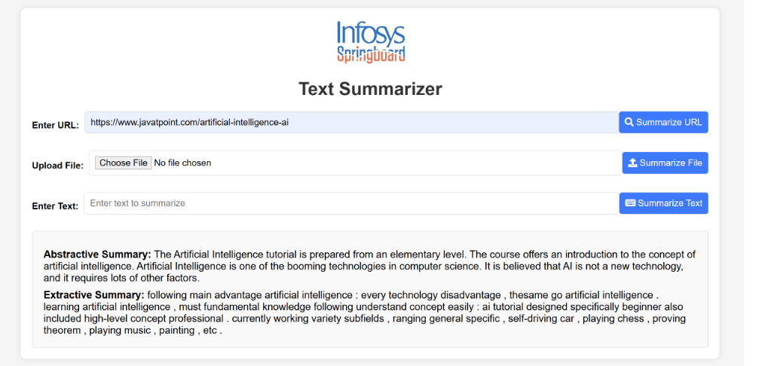
Deployed Application:

Slide 17
Challenges:
· Data Quality: Inconsistent formatting and noise in the dataset required extensive preprocessing.
· Model Selection: Choosing the right model for balancing accuracy and computational efficiency.
· Computational Requirements: High memory and processing power needed for training large language models like BART.
· Performance Evaluation: Measuring the quality of abstractive summaries was challenging due to subjective metrics like ROUGE.
· Domain-Specific Summarization: Difficulty in fine-tuning the model for different use cases like customer reviews and scientific papers.
· Language Limitations: Handling text data in multiple languages or with mixed-language content.
· User Feedback: Incorporating subjective user preferences into objective model improvements.

Slide 18
Future Scope:
· Domain-Specific Models: Develop summarization models tailored for specialized fields like law, medicine, and finance for better accuracy and context understanding.
· Multilingual Summarization: Expand to support multiple languages, making the tool accessible to a global audience.
· Real-Time Summarization: Integrate real-time capabilities for live news, meetings, and chats, enhancing instant information consumption.
· Hybrid Techniques: Combine extractive and abstractive methods with advanced neural architectures to improve summary quality and coherence.
· Personalized Content Delivery: Implement AI-driven personalization to provide user-specific summaries for tailored experiences.
· Integration Opportunities: Embed summarization into platforms like virtual assistants, search engines, and e-learning tools to enhance utility and user engagement.

Slide 19
Conclusion:
The Text Summarization project demonstrates the potential of leveraging advanced NLP techniques to address the challenge of information overload in today’s data-driven world. By employing both extractive and abstractive summarization methods, the project successfully condenses large volumes of text into concise and meaningful summaries.
The implementation highlights the importance of robust preprocessing, model fine-tuning, and performance evaluation in building effective summarization systems. The results showcase the transformative impact of text summarization across various domains such as news, customer reviews, and research papers.
While the project achieved significant milestones, it also opens avenues for further advancements, including multilingual capabilities and real-time applications. Overall, this project underscores the critical role of AI-driven tools in enabling efficient information processing and informed decision-making.

Slide 20
Thank you
Questions?

